Slide 1
St Columba’s Justice and Peace Group
100 Club

Slide 2
St Peter’s, Mbare, Zimbabwe

Slide 3
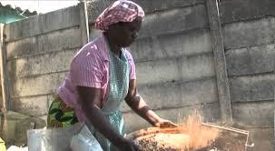
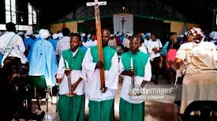

Slide 4
St Columba’s link to St Peter’s Mbare
The link between St Columba’s Justice and Peace group and the parish of St Peter’s in Mbare ( near Harare) in Zimbabwe is a long- lasting and rewarding one.
Over more than a decade the group has built up good relationships with the priests and parishioners and we have been lucky enough to have visits in both directions

Slide 5
This beautiful carving, now at the back of the church, was a gift from the parish and they now have a Celtic cross from us in Scotland.

Slide 6
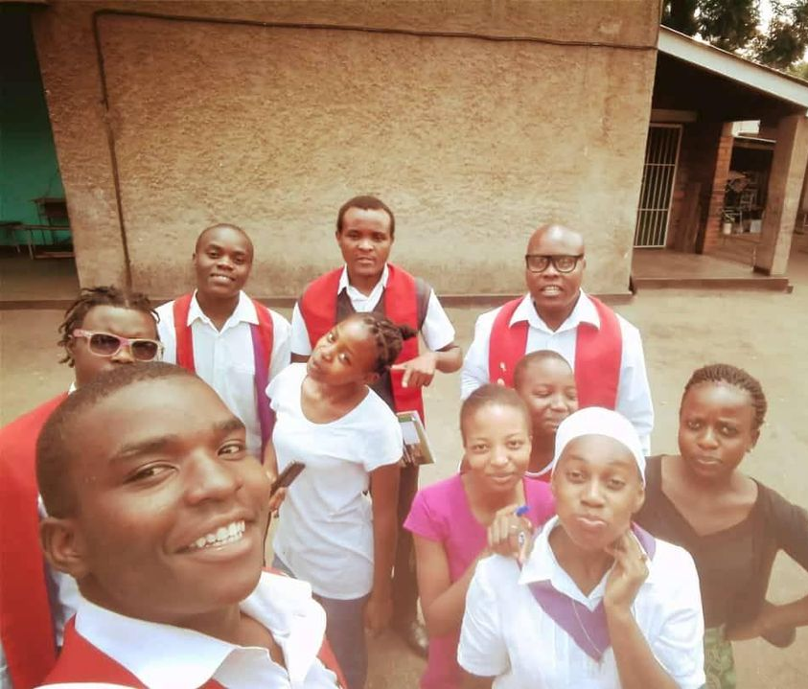
Financial support from St Columba’s has helped the parish in their spiritual life

Slide 7
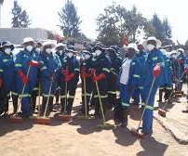
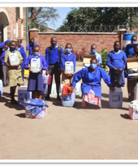
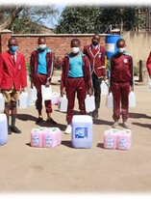
and in practical matters. Young people have organised teams to collect and remove rubbish , clearing the ground of rats and disease.

Slide 8
They have transformed a waste dump into a park for local people

Slide 9
During the COVID pandemic, St Peter’s Mbare was very badly affected and lost many parishioners to the disease. Regular Zoom meetings between the J &P group and Father Nelson showed us how desperate their situation was.

Slide 10
Sadly poverty remains an issue. At the moment the provision of medicines is a huge problem . The Jesuits who run the parish try to buy medicines for those who are simply too poor to access them, but funds are short.

Slide 11
100 Club
The 100 Club has run for many years at St Columba’s and now provides funding for the parish link to St Peter’s , Mbare.
During the COVID period this has sadly declined and some of our regular contributors have left us.
However the need remains and we want to reinvigorate our campaign and make our new parishioners aware of the scheme and the tremendous support it can help to provide.

Slide 12
100 Club
You can buy a number for £20 per year and have a chance to win the monthly prize or even the summer jackpot !
Why not buy more than one number and increase your chances?
It is a great way to support fellow churchgoers in a meaningful way, using a channel that makes sure that every pound gets straight to the people who need it.

Slide 13
100 Club
Please give £20 to Agnes Watson or Steph Mitchell
There are envelopes to help you do this on all the tables.
Please write your name and contact details on the envelope.

Slide 14
100 Club
You can also pay by bank transfer.
Please use your surname as reference so that we know who you are!
Let us know you have sent it so that we can include you in the draw straight away.
St Columba’s Justice and Peace Group
Sort code: 83 19 19
Account number; 00103317

Slide 17
